Slide 1



EDUWAVEA
Problem Statement :
Traditional online meetings lack natural interaction, making collaboration unproductive and failing to replicate in-person communication. Our solution is to develop an AI-powered 3D virtual meeting environment with real-time interactions, natural avatars, and intelligent collaboration tools. This immersive workspace boosts engagement and productivity, seamlessly bridging physical and digital meetings—all without the need for any hardware.
PAGE
01/10

Slide 2



INTRODUCTION
Online meetings often feel distant and bored, making natural interaction difficult. Our project solves this by creating an immersive virtual meeting space inspired by the metaverse, where users join as avatars. They can use a regular screen for accessibility. This flexibility bridges the gap between virtual and real-world meetings. With a simple yet powerful design and interactive features, our platform enhances engagement, making online collaboration more natural and effective—bringing the future of digital communication closer to reality.
PAGE
03/10

Slide 3


FEATURES
AND
FUNCTIONALITIES
3D - Avatars
Real-Time Interactions
Virtual Whiteboard
AI Chatbot
PAGE
04/10

Slide 4



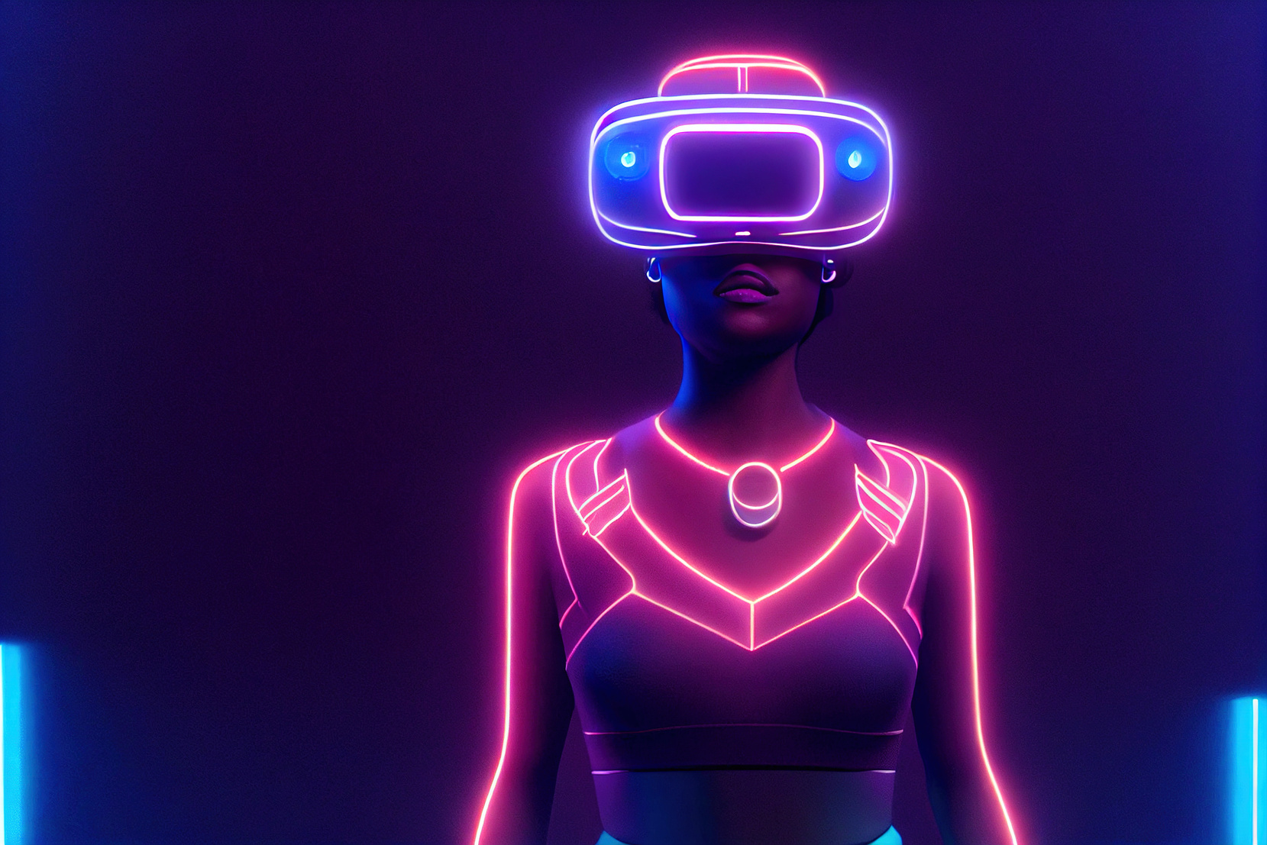
PLATFORMS AND TOOLS USED
Game Engine : Unity 3D
Programming Language : C#
Multiplayer : Photon Pun
Chat bot : Gemini (API key)
Azure : PlayFab Integration
PAGE
05/10

Slide 5
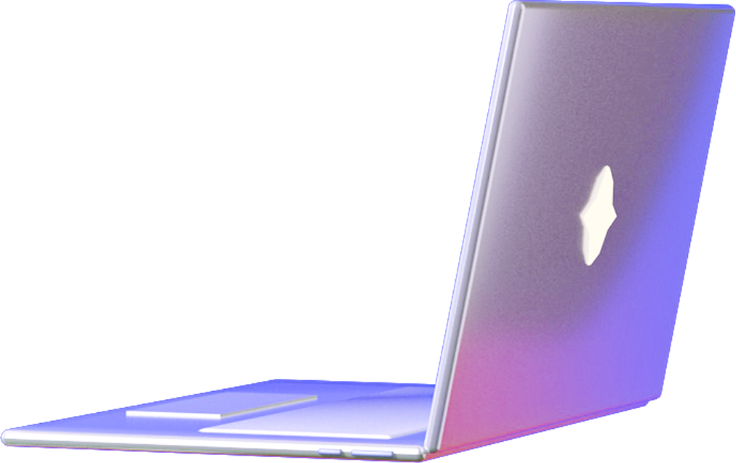
Engaging Learning Environment – Feels more real than regular video calls.
Enhanced Collaboration – Students and teachers can interact instantly.
Interactive Teaching Tools – Includes a whiteboard, avatars, and chat for better learning.
Scalability – Works for schools, universities, and corporate training.
BENEFITS OF THE PROJECT
PAGE
06/10

Slide 6

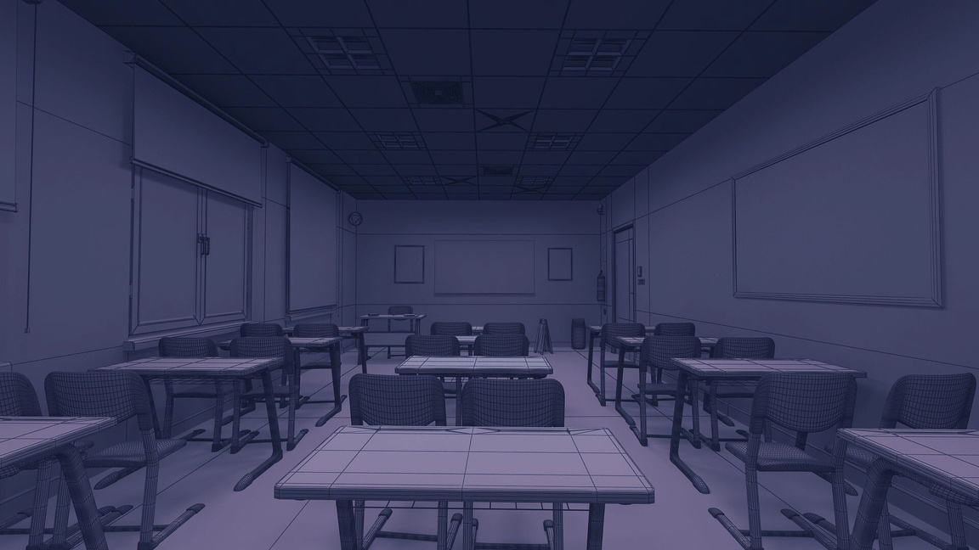
FUTURE
ENHANCEMENTS
More Realistic & Customizable Avatars – Improved animations and expressions.
AI-Powered Tutors – Virtual assistants for better learning support.
Expanded Virtual Environments – Multiple classroom designs.
Mobile & VR Support – Making it accessible across all devices.
6AGE
08/10

Slide 7

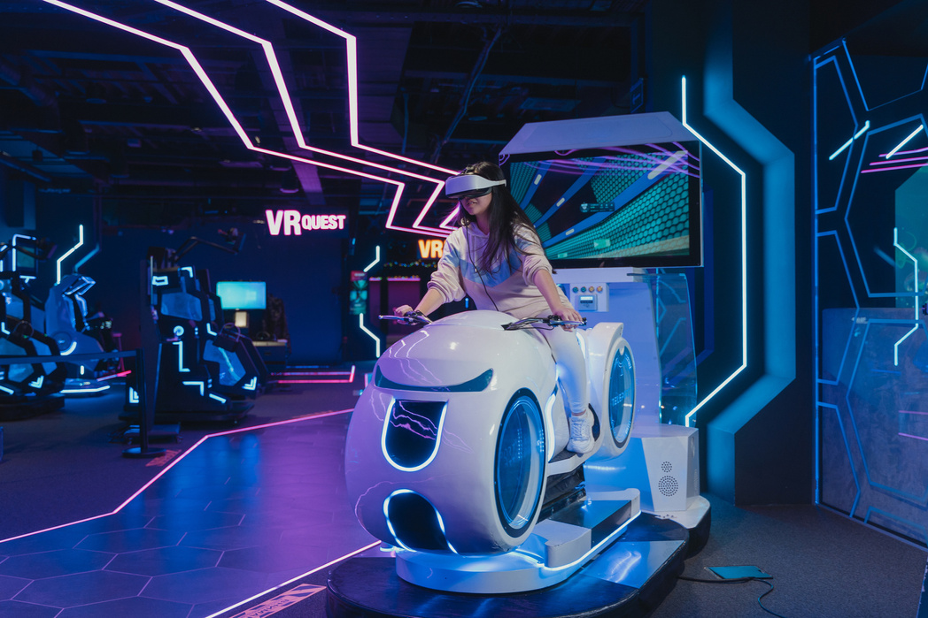

CONCLUSION
By this, we conclude that virtualizing 3D avatars, AI tutors, and real-time collaboration makes online communication more effective and engaging. Supporting both VR and mobile devices, it provides flexibility and accessibility to different users. This innovation increases communication, collaboration, and learning experience, and remote collaboration feels more natural. With the latest developments in technology, these types of solutions will continue to form the future of virtual meetings, learning, and telecommuting, closing the divide between real-life and online interactions.
PPAGE
09/10

